Slide 1
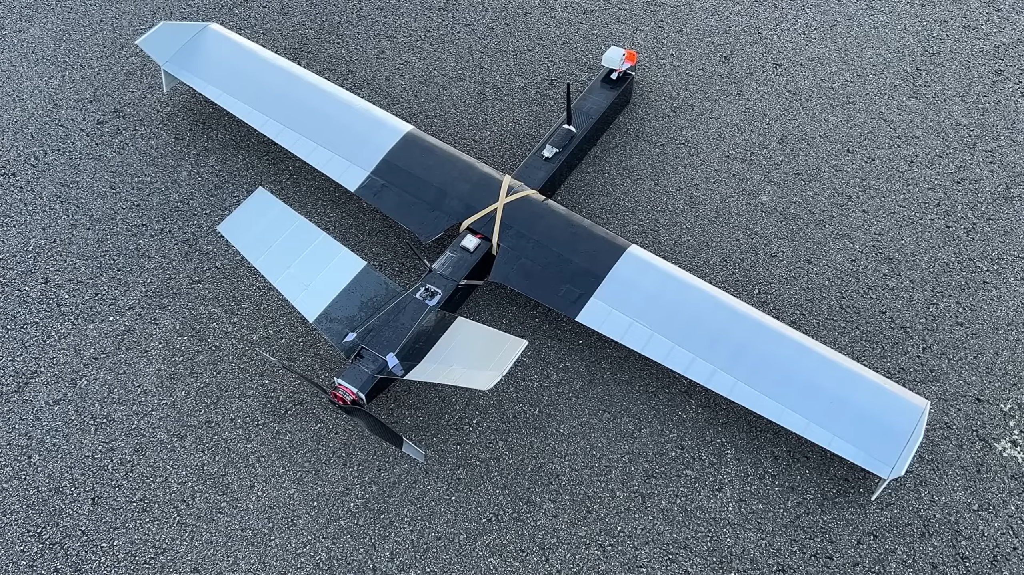
Aviation Physics: Detailed Explanation

Slide 2
Forces Acting on an Airplane
- Lift: Upward force counteracting weight.
- Weight (Gravity): Downward force due to Earth's gravity.
- Thrust: Forward force produced by engines/propellers.
- Drag: Air resistance opposing thrust.
- Balanced forces maintain steady flight.

Slide 3
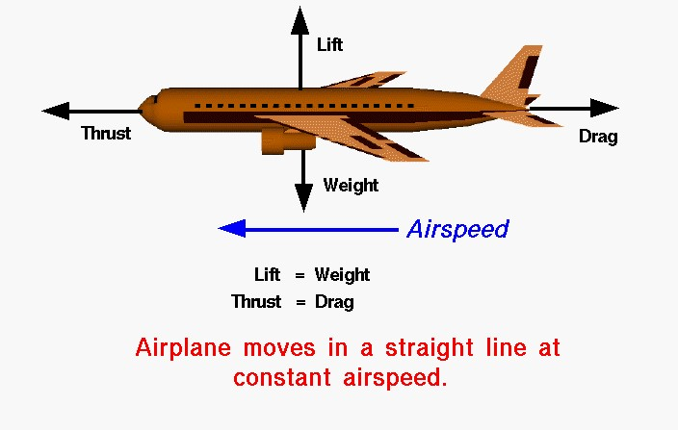

Slide 4
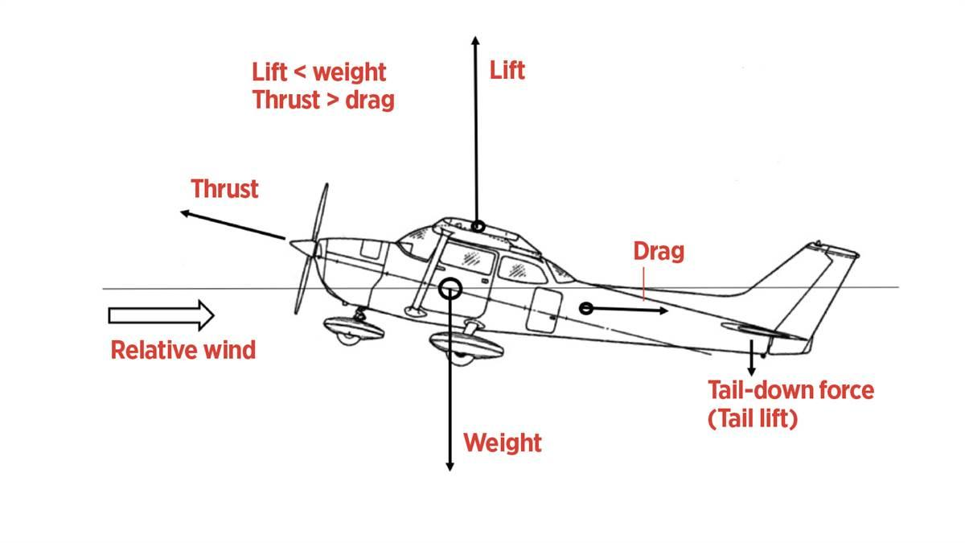

Slide 5
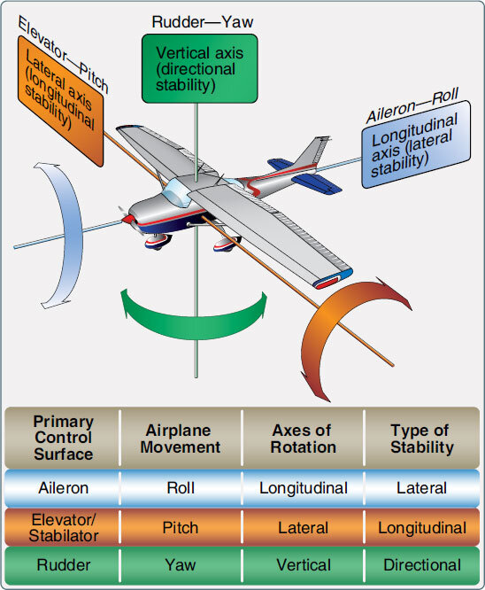

Slide 6
Aircraft Tail Types and Functions
- Conventional Tail: Standard stabilizer configuration, provides stability.
- V-Tail: Reduces weight and drag, uses ruddervators for control.
- T-Tail: Horizontal stabilizer mounted on vertical stabilizer, effective at high speeds.

Slide 7
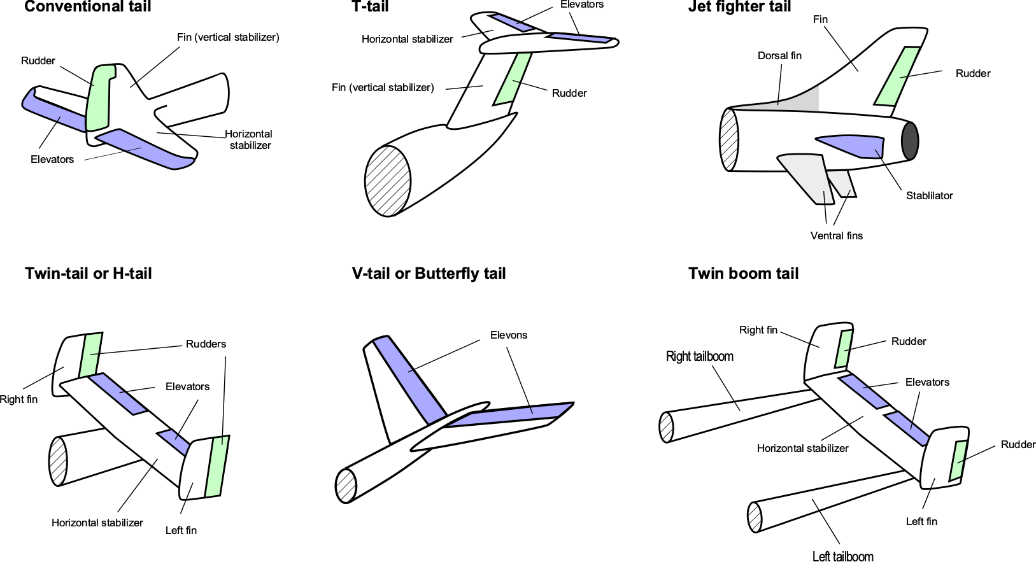

Slide 8
Airfoil, Bernoulli’s Principle, and Angle of Attack
Airfoil: Cross-sectional shape of a wing influencing lift and drag.
Bernoulli’s Principle: Faster airflow over the curved upper wing surface decreases pressure, generating lift.
Bernoulli's principle states that as the speed of a fluid increases, the pressure decreases. This principle is named after Daniel Bernoulli, a Swiss mathematician and physicist.
Angle of Attack (aoa): Angle between the chord line and oncoming airflow.
- Takeoff: Increased (aoa) for more lift.
- Landing: High (aoa) for drag and controlled descent.

Slide 9
Bernoulli’s Principle
In a stremlined flow of incompressible fluid , an increase in fluid’s speed is accompanied by a decrease in its pressure or potential energy.

Slide 10
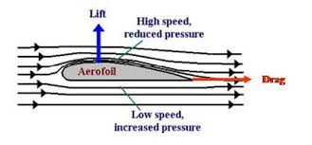

Slide 11
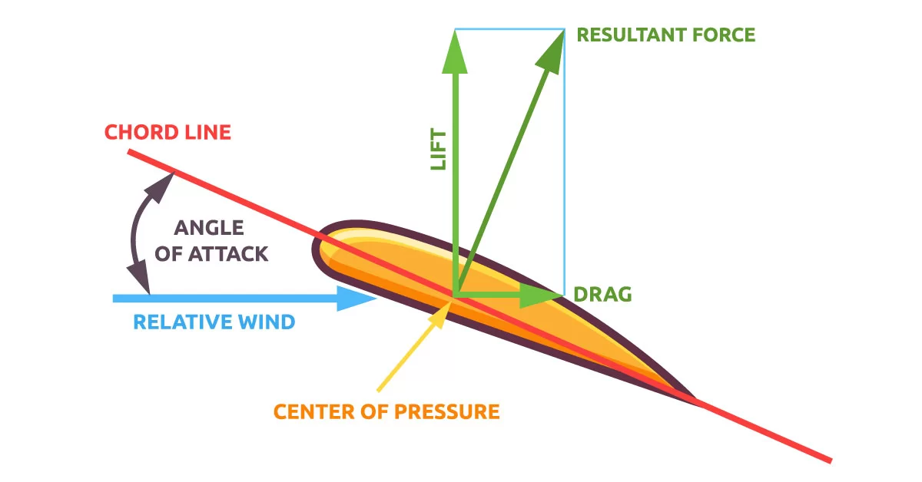

Slide 12
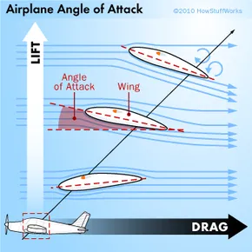

Slide 13
Controlling Components of an Aircraft
- Elevators (Pitch Control): Located on horizontal stabilizer, controls nose up/down movement.
- Ailerons (Roll Control): Found on wings' trailing edge, controls banking left/right.
- Rudder (Yaw Control):Located on vertical stabilizer, controls nose left/right movement.

Slide 14
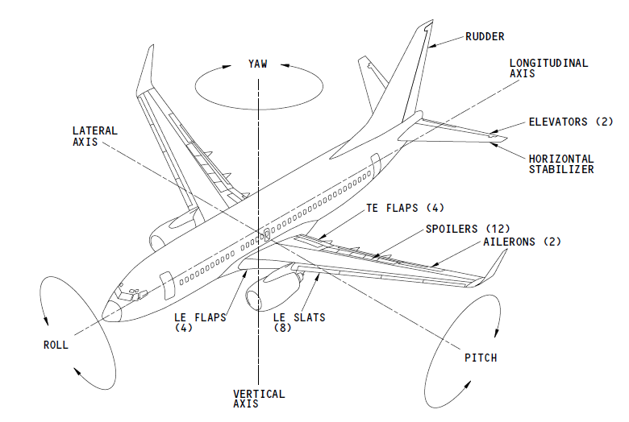

Slide 15
Aircraft Motions: Pitch, Yaw, and Roll
- Pitch: Rotation around lateral axis (controlled by elevators).
- Yaw: Rotation around vertical axis (controlled by rudder).
- Roll: Rotation around longitudinal axis (controlled by ailerons).
- Combination of yaw and roll ensures smooth turns.

Slide 16
Wing Types and Aspect Ratio
Wing Types:
- Straight Wings: High lift, used in slow aircraft.
- Swept Wings: Reduced drag, common in jets.
- Delta Wings: Triangular shape, used in supersonic aircraft.
- Elliptical Wings: Efficient lift, seen in older fighters.
Aspect Ratio:
Aspect Ratio = (Wing Span)² / Wing Area
- High Aspect Ratio: Efficient for gliders, airliners.
- Low Aspect Ratio: Better maneuverability for fighter jets.

